Slide 1


RISE KRISHNA SAI GANDHI GROUP OF INSTITUTIONS
(Affiliated to JNTU, Kakinada)
DEPARTMENT OF COMPUTER SCIENCE & ENGINEERING
AI BASED AUTOMATIC EXAMINATION
PAPER EVALUATION SYSTEM
T. Ramya Sai 228B1A0526
S.Harika Devi 228B1A0519
A. Teja Sri 228B1A0502
P. Vijaya Sri 228B1A0517
Under the guidance of:
Mr. G. Gopi
(Assistant professor)

Slide 2


CONTENTS
1. 2. 3.
4.
ABSTRACT
INTRODUCTION EXISTING SYSTEM
5.
SRS (System Requirements Specification)
6.
ARCHITECTURE
PROPOSED SYSTEM
7.
LITERATURE SURVEY

Slide 3
ABSTRACT
Manual evaluation of subjective answer papers is time-consuming and tiring. Artificial Intelligence can be used to automate this process. Most existing systems rely on keyword matching and word count methods, which fail to capture the actual meaning of answers. Another challenge is the lack of well-curated datasets. This paper proposes an automatic evaluation system using machine learning and natural language processing techniques. Tools such as WordNet, Word2Vec, and TF-IDF are used for text representation. Similarity measures like cosine similarity and Word Mover’s Distance are applied to compare answers. Student responses are evaluated against solution statements and key concepts. Experimental results show that Word Mover’s Distance performs better than cosine similarity. The system achieved 88% accuracy without using Multinomial Naïve Bayes. Including Naïve Bayes further reduced the error rate.

Slide 4

INTRODUCTION
The project automates the evaluation of subjective
examination answers using Artificial Intelligence and Natural Language Processing (NLP).
It analyzes student answers by comparing them with model answers based on semantic similarity, keywords, and language structure.
The system reduces manual effort and time consumption. It ensures fair, consistent, and unbiased grading, minimizing human errors and subjectivity.
Advanced text processing techniques like tokenization, cleaning, and semantic analysis are used to handle varied student responses.

Slide 5


EXISTING SYSTEM
Uses basic NLP and machine learning techniques to evaluate subjective answers. Compares answers using text similarity and classification models. Faces challenges with synonyms, varying answer lengths, and sentence order.

Slide 6
DISADVANTAGES
Human Error and Fatigue:
Manual grading is susceptible to errors due to human fatigue, leading to inconsistent scoring
and potential re-evaluation requests.
Delayed Feedback Cycle:
The protracted grading process results in delayed feedback to students, hindering their leaming
Scalability Issues:
and improvement process.
As student numbers grow, manual evaluation becomes increasingly impractical and
unsustainable, straining educational institutions.
Resource Misallocation:
Valuable faculty time, which could be dedicated to teaching or research, is instead consumed
by repetitive grading tasks.

Slide 7
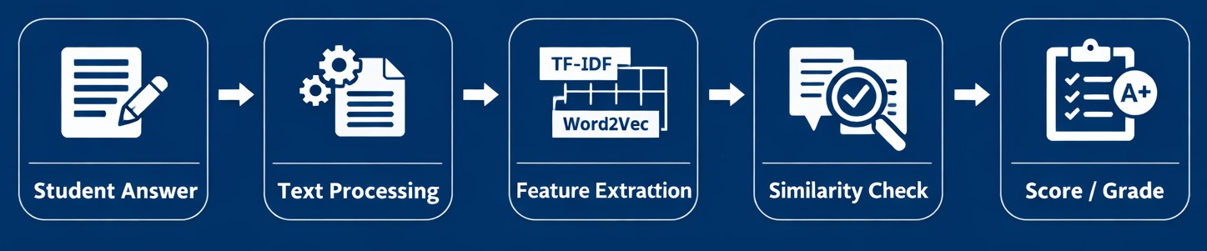
PROPOSED SYSTEM
The proposed system uses advanced AI, Machine Learning, and NLP techniques to automatically evaluate subjective answers with higher accuracy. It performs semantic analysis using methods like Word2Vec, Word Mover’s Distance (WMD), TF-IDF, and Naive Bayes to understand meaning rather than exact words. The system provides fair, consistent, and efficient grading, reducing human bias, evaluation time, and manual effort.

Slide 8
ADVANTAGES
Rapid Evaluation:
Quickly processes large volumes of exams, significantly reducing grading time and
enabling faster feedback for students.
Unbiased Assessment:
Employs objective criteria and algorithms to ensure fair and consistent grading,
minimizing human subjectivity and enhancing integrity.
Adaptive Learning:
Machine learning capabilities allow the system to adapt to various question types and
improving accuracy over time.
Enhanced Insights:
Provides valuable data analytics on student performance and common misconception
aiding educators in refining teaching strategies.

Slide 9
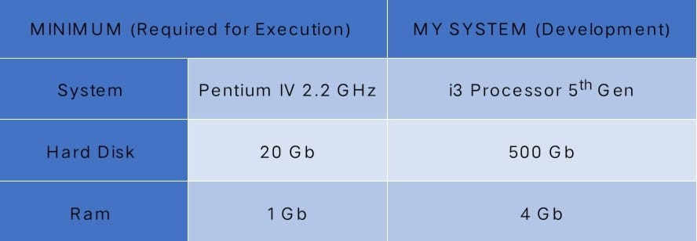
HARDWARE REQUIREMENTS

Slide 10
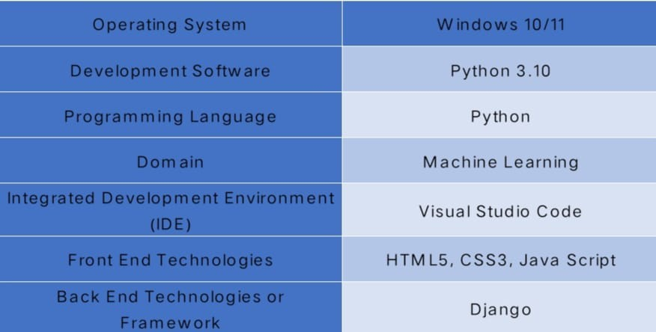
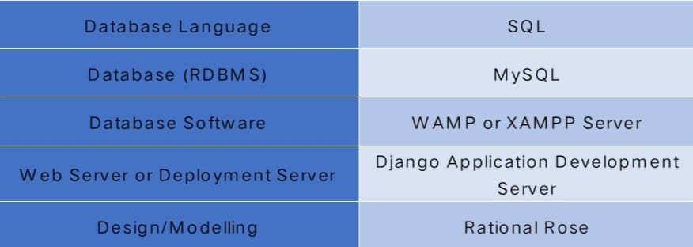
SOFTWARE REQUIREMENTS

Slide 11
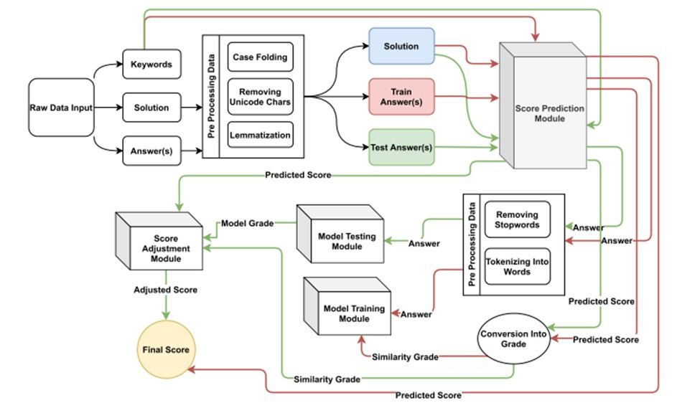
ARCHITECTURE

Slide 12
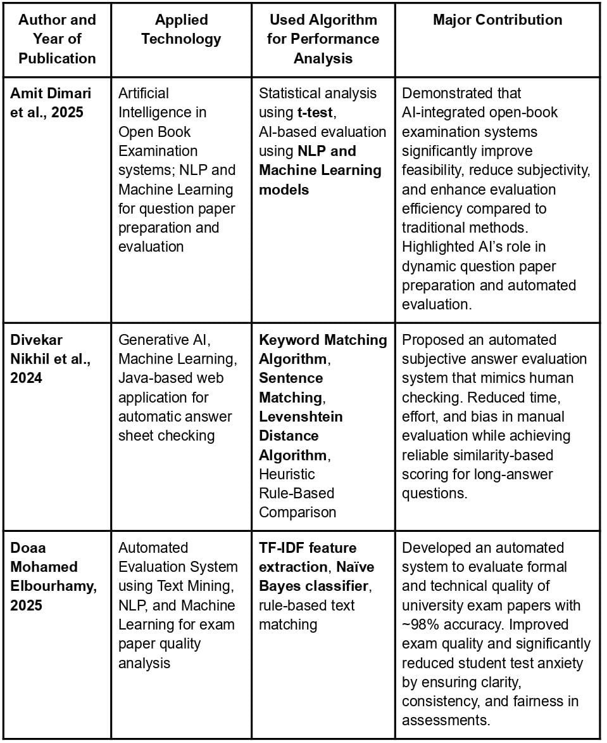
LITERATURE SURVEY

Slide 13


